Slide 1
Let L=
{ w= u v : u ∈ {a, b}*, v ∈ {c, d}* and |u|= |v|}
Design a context-free grammar that generates L.
Use your grammar and the construction from last class to design a PDA that accepts L.

Slide 2
No class or tutorial on Tuesday July 3: reading break is July 2-3 for May to August classes.
During reading break: try doing problems on old midterm and final exams. Our final exam is fast approaching.

Slide 3
The worst question on the midterm was Question #4. These were on previous midterms. Make sure you know how to work all the questions on the old final exams and ask about them at the final exam tutorial if you are unsure of the answers.
Results for Question #4:
Number Correct | Number of students
0 | 13
1 | 14
2 | 2
3 | 1
4 | 1

Slide 4
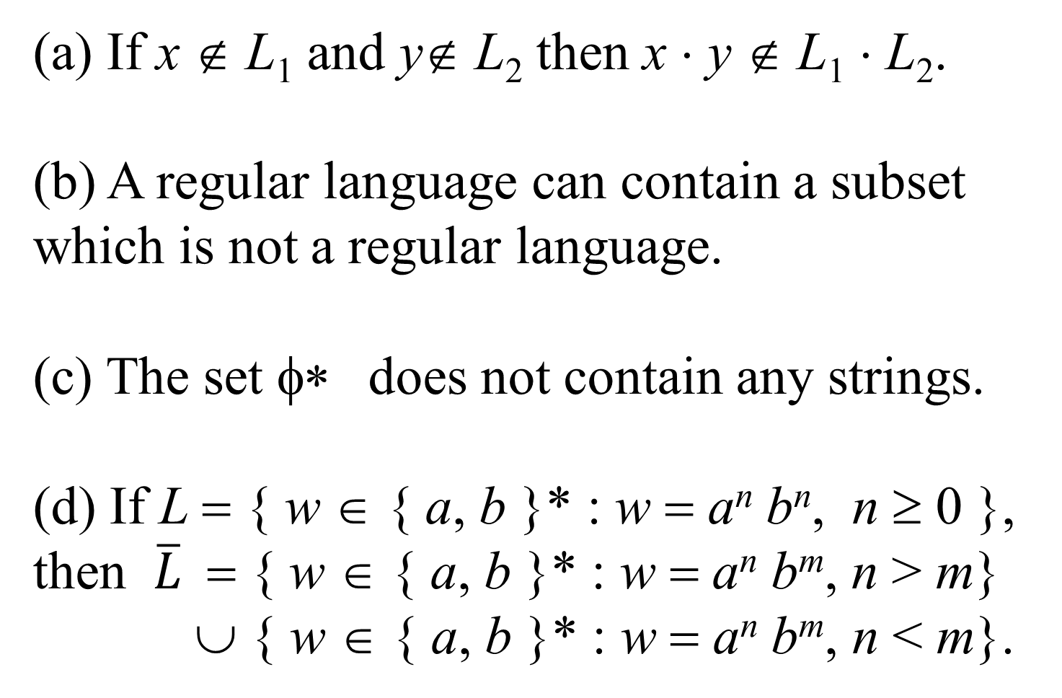
(a) If x ∉ L₁ and y∉ L₂ then x ⋅ y ∉ L₁ ⋅ L₂.
(b) A regular language can contain a subset which is not a regular language.
(c) The set φ∗ does not contain any strings.
(d) If L = { w ∈ { a, b }* : w = a^{n} b^{n}, n ≥ 0 }, then $\overline{L}$= { w ∈ { a, b }* : w = a^{n} b^{m}, n > m}
∪ { w ∈ { a, b }* : w = a^{n} b^{m}, n < m}.

Slide 5
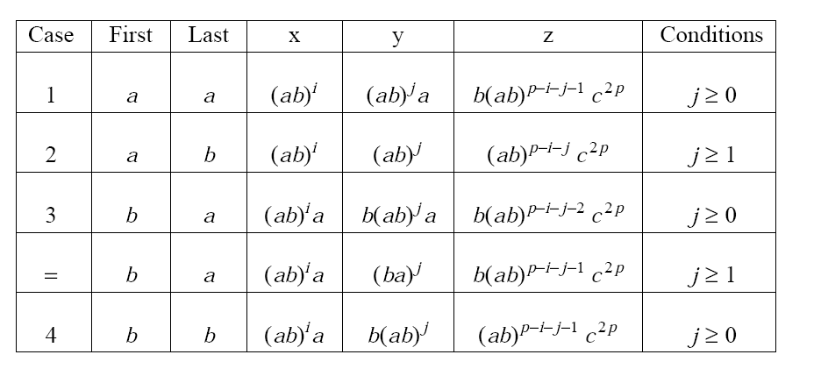
To organize your cases for the pumping lemma question, group according to first/last symbol of y:
What happens if there is some c’s in x or in y?

Slide 6
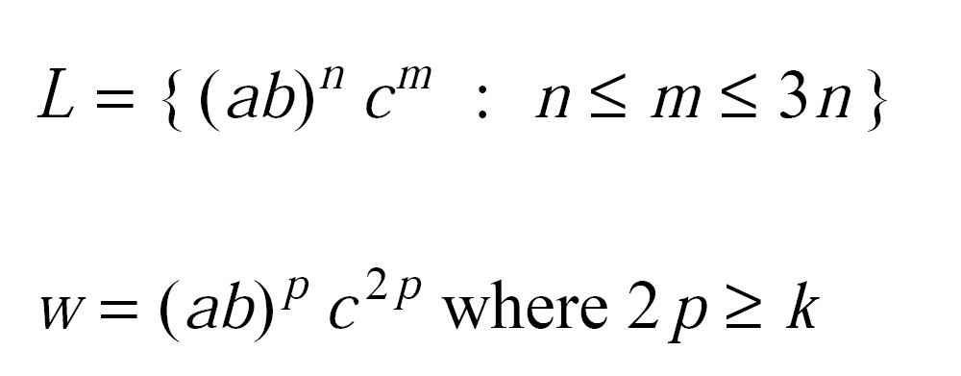

Slide 7
Closure Properties of Context-free Languages
Intersecting a context-free language and a regular language gives a context-free language.
Context-free languages are closed under union, concatenation and Kleene star.
Context-free languages are not closed under intersection or complement.
Thought question: are they closed under difference/exclusive or?

Slide 8
Theorem:
If L₁ is context-free and L₂ is regular then L₁ ⋂ L₂ is context-free.
Proof:
By construction. This proof is similar to the one on the assignment proving closure of regular languages under intersection.

Slide 9
L= { w c w^{R} : w ∈ {a, b}* } ⋂ a* c a*
Start state: s, Final State: {t}
State | Input | Pop | Next state | Push
s | a | ε | s | A
s | b | ε | s | B
s | c | ε | t | ε
t | a | A | t | ε
t | b | B | t | ε

Slide 10
Theorem:
Context-free languages are closed under union, concatenation and Kleene star.
Proof: By construction.
Let G₁ = (V₁, Σ, R₁, S₁) and
let G₂ = (V₂, Σ, R₂, S₂).
We show how to construct a grammar G= (V, Σ, R S) for L(G₁) ⋃ L(G₂), L(G₁) ۰ L(G₂), and L(G₁)*.

Slide 11
L₁ = { a^{n} b^{2n} : n ≥ 0}
S₁ →a S₁ bb
S₁ →ε
L₂ = { u u^{R} v : u, v in {a, b}⁺}
S₂ → U₂ V₂
U₂ → a U₂ a
U₂ → b U₂ b
U₂ → aa
U₂ → bb
V₂ → a V₂
V₂ → b V₂
V₂ → a
V₂ → b

Slide 12
L₁ = { a^{n} b^{2n} : n ≥ 0}
S₁ →a S₁ bb
S₁ →ε
UNION:
Start symbol S
S → S₁ S → S₂
L₂ = { u u^{R} v : u, v in {a, b}⁺}
S₂ → U₂ V₂
U₂ → a U₂ a
U₂ → b U₂ b
U₂ → aa
U₂ → bb
V₂ → a V₂
V₂ → b V₂
V₂ → a
V₂ → b

Slide 13
L₁ = { a^{n} b^{2n} : n ≥ 0}
S₁ →a S₁ bb
S₁ →ε
CONCATENATION:
Start symbol S
S → S₁ S₂
L₂ = { u u^{R} v : u, v in {a, b}⁺}
S₂ → U₂ V₂
U₂ → a U₂ a
U₂ → b U₂ b
U₂ → aa
U₂ → bb
V₂ → a V₂
V₂ → b V₂
V₂ → a
V₂ → b

Slide 14
KLEENE STAR:
Start symbol S
S → S₁ S
S → ε
L₁ = { a^{n} b^{2n} : n ≥ 0}
S₁ →a S₁ bb
S₁ →ε

Slide 15
KLEENE STAR: Start symbol S
S → S₂ S
S → ε
L₂ = { u u^{R} v : u, v in {a, b}⁺}
S₂ → U₂ V₂
U₂ → a U₂ a
U₂ → b U₂ b
U₂ → aa
U₂ → bb
V₂ → a V₂
V₂ → b V₂
V₂ → a
V₂ → b

Slide 16
Theorem: L = { a^{n} b^{n} c^{n} : n ≥ 0} is not context-free.
Proof: Next class using the pumping theorem for context-free languages.
Today: assume it is true.

Slide 17
L₁ = { a^{p} b^{q} c^{r} : p = q }
Design a context-free grammar for L₁.
L₂ = { a^{p} b^{q} c^{r} : p = r }
Design a PDA for L₂.
This proves L₁ and L₂ are context-free.
L₁ ⋂ L₂ = { a^{n} b^{n} c^{n} : n ≥ 0}.
Therefore, context-free languages are not closed under intersection.

Slide 18
L = { a^{n} b^{n} c^{n} : n ≥ 0}
L₁ = { a^{p} b^{q} c^{r} : p ≠ q }
L₂ = { a^{p} b^{q} c^{r} : p ≠ r }
L₃ = { a^{p} b^{q} c^{r} : q ≠ r }
The complement of L is NOT equal to
L₁ ⋃ L₂ ⋃ L₃.
Which strings are in the complement of L but not in L₁ ⋃ L₂ ⋃ L₃?

Slide 19
L = { a^{n} b^{n} c^{n} : n ≥ 0}
L₁ = { a^{p} b^{q} c^{r} : p ≠ q }
L₂ = { a^{p} b^{q} c^{r} : p ≠ r }
L₃ = { a^{p} b^{q} c^{r} : q ≠ r }
L₄ = { w ∈ {a, b, c}* : w ∉ a* b* c*}
L₁ ⋃ L₂ ⋃ L₃⋃ L₄ is context-free and is the complement of L.
Therefore, context-free languages are not closed under complement.

