Slide 1
Design contex-free grammars that generate:
L₁= { u v : u ∈ {a,b}* , v ∈ {a, c}*,
and |u| ≤ |v| ≤ 3 |u| }.
L₂= { a^{p} b^{q} c^{p} a^{r} b^{2r} : p, q, r ≥ 0}

Slide 2
Midterm tutorial: Monday June 25 at 7:30pm, ECS 116.
Tutorial this week: Bring any questions you have about assignment #3 or old midterms. Material covered if you have no other questions: Context-free grammars and Pushdown Automata.
Assignment #3 is due at the beginning of class on Tuesday June 26.

Slide 3


Slide 4
Today:
We will go back over more examples of context-free grammars, pushdown automata and parse trees. I previously went through that material fairly quickly so you would be able to do the assignment last weekend if you wanted to.

Slide 5
L= {w ∈ {a,b}* : w has abb and a prefix and bba as a suffix}
Create a regular context-free grammar that generates L.
2. Give a context-free grammar for L that is not regular.
Recall: A regular context-free grammar can have at most one non-terminal on the RHS of each rule, if there is a non-terminal, it is the last symbol on the RHS of the rule.

Slide 6
L(M)= { w ∈ Σ* : (s, w, ε) ├* (f, ε, ε) for some final state f in F}.
To accept, there must exist a computation which:
Starts in the start state with an empty stack.
Applies transitions of the PDA which are applicable at each step.
Consumes all the input.
Terminates in a final state with an empty stack.

Slide 7
PDA’s are non-deterministic:
L= { w w^{R} : w ∈ {a, b}* }
Start state: s, Final State: {t}
State | Input | Pop | Next state | Push
s | a | ε | s | A
s | b | ε | s | B
s | ε | ε | t | ε
t | a | A | t | ε
t | b | B | t | ε
Guessing wrong time to switch from s to t gives non-accepting computations.

Slide 8
Some non-accepting computations on aaaa:
1. Transfer to state t too early:
(s, aaaa, ε) ⊢ (s, aaa, A)⊢ (t, aaa, A)
⊢ (t, aa, ε)
Cannot finish reading input because stack is empty.
2. Transfer to state t too late:
(s, aaaa, ε) ⊢ (s, aaa, A)⊢(s, aa, AA)
⊢(s, a, AAA) ⊢(t, a, AAA) ⊢ (t, ε , AA)
Cannot empty stack.

Slide 9
Accepting computation on aaaa:
(s, aaaa, ε) ⊢ (s, aaa, A)⊢ (s, aa, AA)
⊢ (t, aa, AA) ⊢ (t, a, A) ⊢ (t, ε, ε)
The computation started in the start state with the input string and an empty stack.
It terminated in a final state with all the input consumed and an empty stack.

Slide 10
L= {w in {a, b}* : w has the same number of a’s and b’s}
Start state: s
Final states: {s}
State | Input | Pop | Next state | Push
s | a | ε | s | B
s | a | A | s | ε
s | b | ε | s | A
s | b | B | s | ε

Slide 11
L= {w in {a, b}* : w has the same number of a’s and b’s}
State state: s, Final states: {f}
State | Input | Pop | Next state | Push
s | ε | ε | t | X
t | a | X | t | BX
t | a | A | t | ε
t | a | B | t | BB
t | b | X | t | AX
t | b | A | t | AA
t | b | B | t | ε
t | ε | X | f | ε
A more deterministic solution:
Stack will never contain both A’s and B’s.
X- bottom of stack marker.

Slide 12
Parse Trees- G = (V, Σ, R S)
Nodes of parse trees are each labelled with one symbol from V ⋃ {ε} .
Node at top- root, labelled with start symbol S.
Leaves- nodes at the bottom.
Yield- concatenate together the labels on the leaves going from left to right.

Slide 13
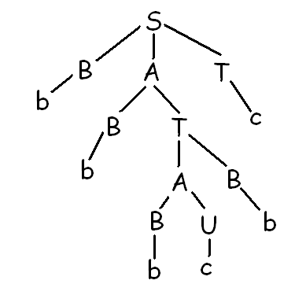
Find the leftmost derivation for this parse tree.

Slide 14
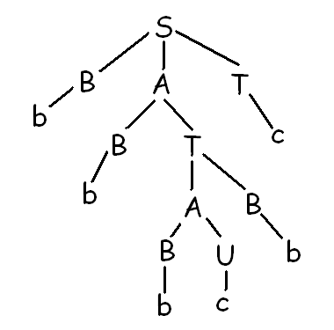
To pump:
Look for a path from root with a repeated non-terminal.

Slide 15
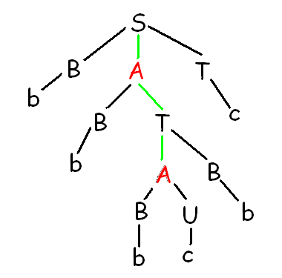
Path:
S - A - T - A
Non-terminal A is repeated.

Slide 16
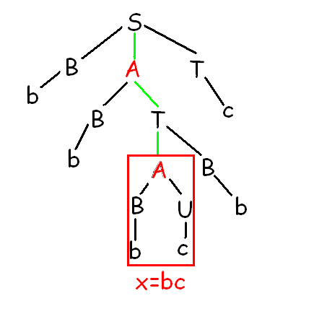
Yield from second copy downwards gives x.

Slide 17
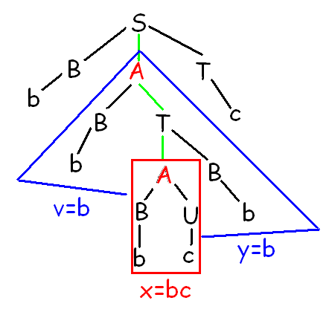
Consider tree from first copy downwards.
Yield before x is v.
Yield after x is y.

Slide 18
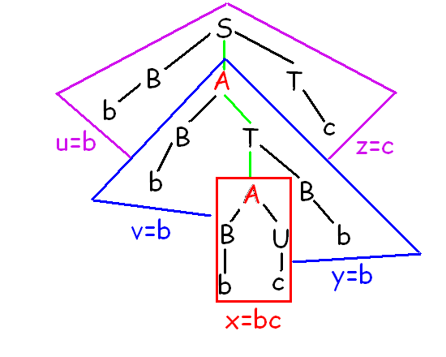
Yield of whole tree before v is u.
Yield after y is z.

Slide 19
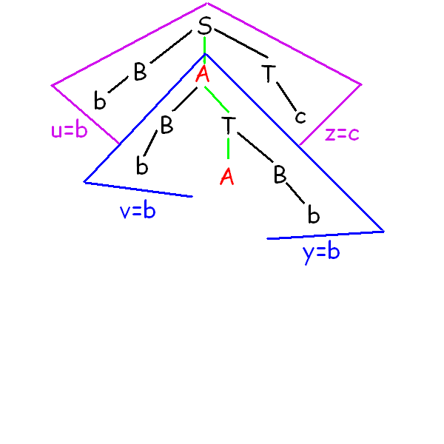
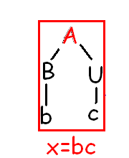
Cut off part of tree from second copy downwards.

Slide 20
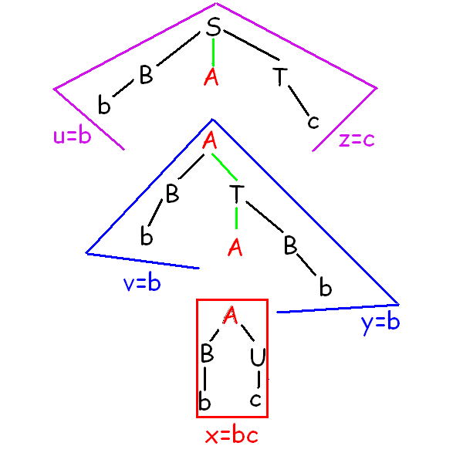
Cut off part from first copy downwards.

Slide 21
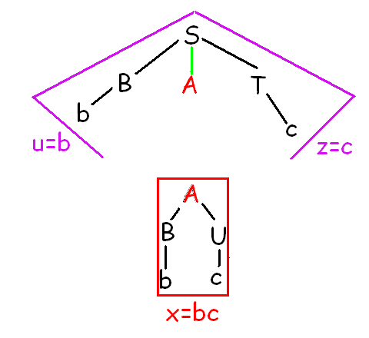
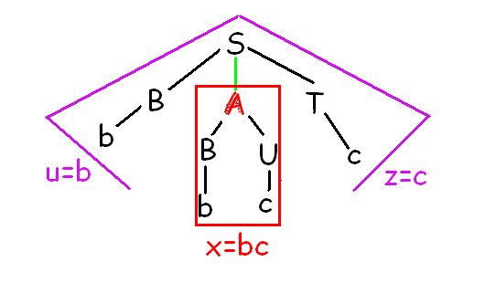
To pump zero times:
New yield:
u x z = b bc c
= u v⁰ x y⁰ z

Slide 22
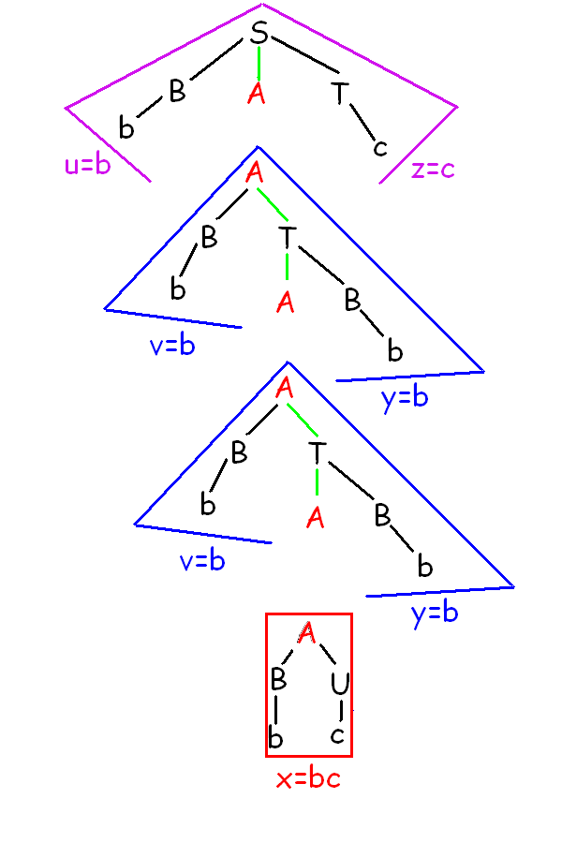
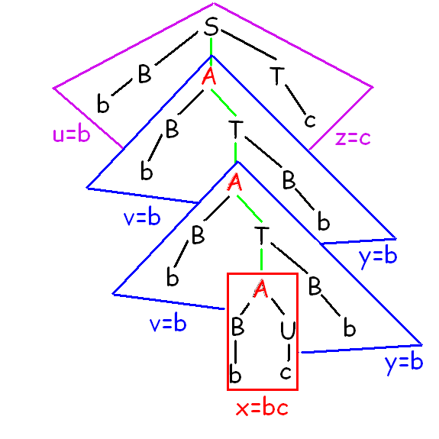
To pump twice:

Slide 23
Pumping twice:
New yield is:
u v v x y y z
= u v² x y² z

Slide 24
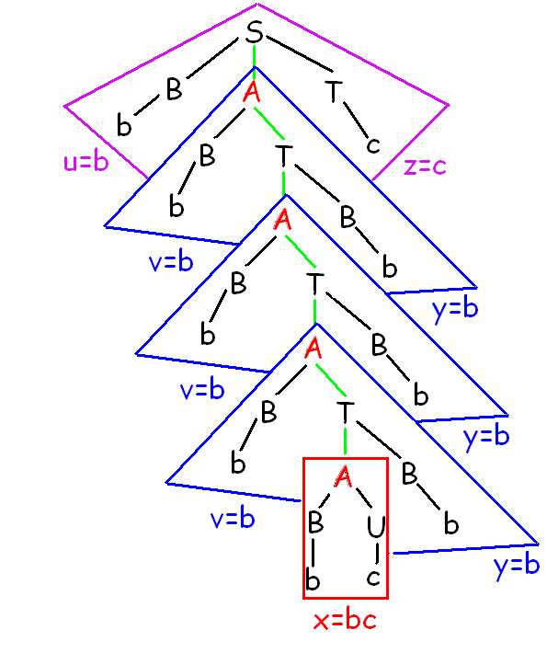
To pump three times:
New yield is:
u vvv x yyy z
= u v³ x y³ z

Slide 25
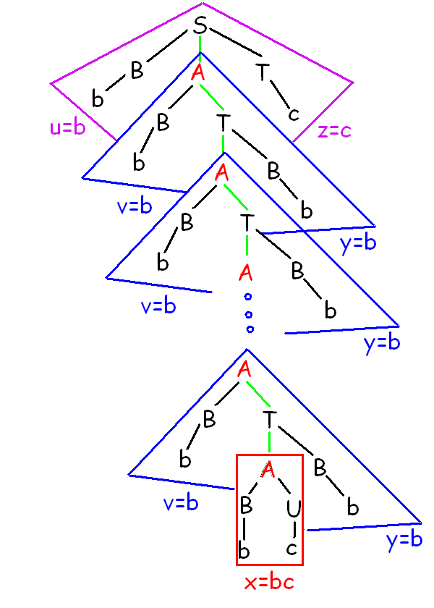
To pump n times:
New yield is:
= u v^{n} x y^{n} z

Slide 26
The Pumping Theorem for Context-Free Languages:
Let G be a context-free grammar.
Then there exists some constant k which depends on G such that for any string w which is generated by G with |w| ≥ k,
there exists u, v, x, y, z, such that
w= u v x y z,
|v| + |y| ≥ 1, and
u v^{n} x y^{n} z is in L for all n ≥ 0.

Slide 27
Draw a parse tree for the following derivation:
S ⇒ C A C ⇒ C A b b ⇒ b b A b b⇒
b b B b b ⇒ b b a A a a b b
⇒ b b a b a a b b
2. Show on your parse tree u, v, x, y, z as per the pumping theorem.
3. Prove that the language for this question is an infinite language.

