Slide 1
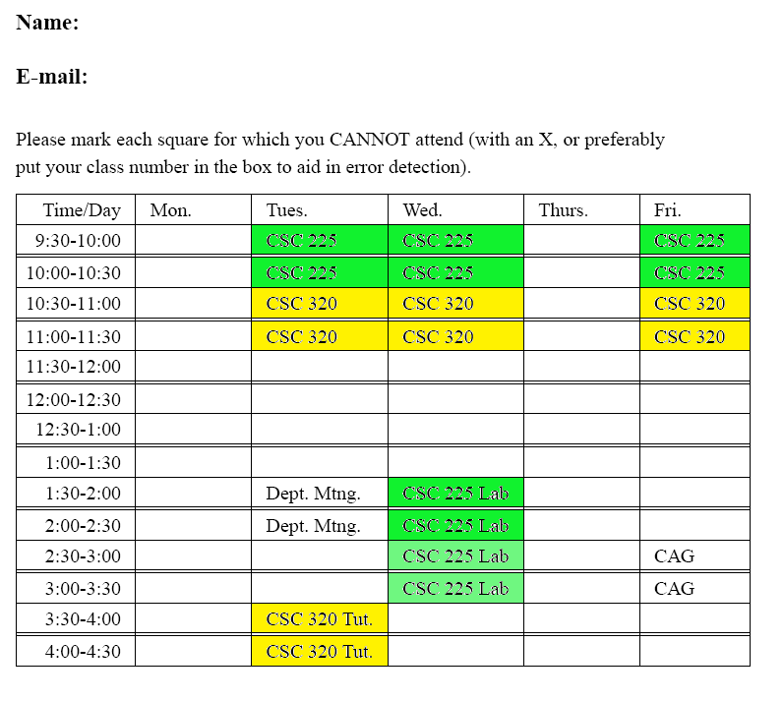
Put your name if you want your attendance credit.
Please put your e-mail as well.
CSC 320 is done at 11:30 so I did NOT fill in the box for 11:30 for our class.

Slide 2
CSC 320: Proof of the Day
Definition: for functions f and g which map the natural numbers to real values, the function f(n) is in O(g(n)) if there exists constants c > 0 and n_{o} ≥ 0 such that for all
n ≥ n₀, f(n) ≤ c ۰g(n).
Use this definition to prove that
3 + 4 n + 5 n² + 2 n³ is in O(n³).

Slide 3
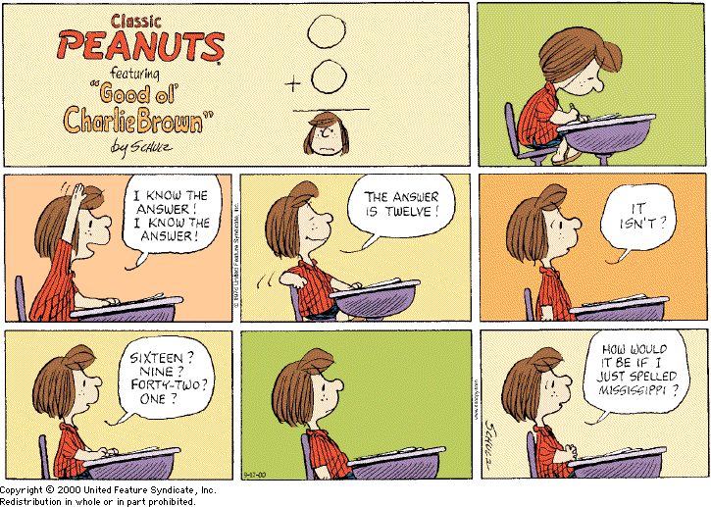
You will learn a lot more if you try the problems and get them wrong than if you do not try. Also, it helps me know where the class is in terms of understanding.

Slide 4
Announcements
If you are on my connex roster, you should have received an e-mail I sent out Thursday reminding you to bring your schedule to class today. Please make sure you can access connex.
Start work now on assignment #1. Please ask me questions if any of the instructions are not clear to you.
Your first tutorial is this Tuesday at 3:30pm.
Note: you don’t have to wait until the tutorial if you have questions. Ask me or send me e-mail.

Slide 5

$$\sum_{i=c}^{n}{f(i)}$$
Meaning of notation (translation to code):
sum= 0;
for (i=c; i ≤ n; i++)
sum= sum + f(i);
The value of the expression is sum at the termination of this loop.

Slide 6




Some students did not include limits and others omitted the name of the summation variable on the summations. This means that what you wrote is not properly defined.
(a)
$$\sum_{i=0}^{k}{2^{i}}$$
(c)
$$\sum_{i=0}^{k}{2^{i+1}}$$
(d)
$$\sum_{j=0}^{k+1}{2^{i}}$$
(b)
$$\sum_{i=0}^{k+1}{2^{i}}$$

Slide 7

Natural Numbers
= { 0, 1, 2, 3, 4, … }
Inductive Definition:
[Basis] 0 is in the set
[Inductive step]:
If k is in
then k+1 is in

Slide 8
The idea behind the simplest form of an induction proof:
Suppose we are given a statement S(n) and we want to show that S(n) is true for all integers n ≥ 0.
If we prove:
that S(0) is a true statement, and
if S(n) is a true statement then so is S(n+1)
then this is sufficient to prove that S(n) is true for all integers n ≥ 0.

Slide 9
_{k}
Theorem S(k): Σ 2^{i =} 2 ^{k+1} - 1
^{i=0}
Proof:
[Basis] When k=0, Σ_{i=0 to k} 2^{i} = 2⁰ = 1 and
2^{k+1} – 1 = 2⁰⁺¹ -1 =1 so this formula is correct for k=0.
Note: the induction hypothesis which I will use for this proof is the statement (hypothesis since we have not finished proving it yet) S(k):
_{k}
Σ 2^{i} = 2^{k+1} - 1. We are trying to prove S(k+1).
i=0
_{k+1}
S(k+1): Σ 2^{i =} 2 ^{(k+1)+1} - 1
^{i=0}

Slide 10
[Induction step] Assume S(k) is true.
We want to prove S(k+1). Separating the sum into two parts gives
_{k+1}
Σ 2^{i} =
i=0
k
Σ 2^{i} + 2^{k+1}.
^{i=0}
By the induction hypothesis, the red term above is equal to 2^{k+1} – 1. Therefore,
IMPORTANT: always indicate to your reader where you apply the induction hypothesis.

Slide 11
_{k+1}
Σ 2^{i} =
i=0
2^{k+1} - 1 + 2^{k+1} = 2 * 2^{k+1} - 1 = 2^{k+2} – 1 = 2^{(k+1) + 1} – 1
as required.

Slide 12
Common problem in solutions submitted:
Many students applied the induction hypothesis without explaining to the reader what you were doing. You will lose marks on the assignment if you do not explain where you are applying the induction hypothesis.
A proof is intended for someone to read. It will be easier for someone to understand and believe in your proof if you explain what you are doing algebraically at every step.
Your proof will be more elegant if you don’t change the variable names (for this problem, stick to k instead of switching to j or n or m or l).

Slide 13
Standard approach to an induction proof that for all n ≥ 0, f(n)= g(n):
[Basis] Prove that f(0)= g(0).
[Induction step]
Assume that f(n)= g(n). We want to prove that f(n+1)= g(n+1).
The induction hypothesis is the mathematical statement that f(n)=g(n).

Slide 14
Rewrite f(n+1) in terms of some terms involving f(n) and some other terms by applying standard mathematics.
Replace f(n) by g(n). This is called applying the induction hypothesis. On your assignments, I want you to explain what you are doing at this step by writing:
By induction, f(n) = g(n) and therefore, ….
They may not teach this in Math 122, but a good mathematician explains what they are doing at every step of a proof.
3. Simplify algebraically until you have shown that f(n+1) = g(n+1).

Slide 15
_{k}
Theorem: Σ 2^{i =} 2 ^{k+1} - 1
^{i=0}
Proof:
[Basis] When k=0, Σ_{i=0 to k} 2^{i} = 2⁰ = 1 and
2^{k+1} – 1 = 2⁰⁺¹ -1 =1 so this formula is correct for k=0.
Assume that
_{k}
Σ 2^{i} = 2^{k+1} - 1. We want to prove that
i=0
_{k+1}
Σ 2^{i =} 2 ^{(k+1)+1} - 1 = 2^{k+2} -1.
^{i=0}
Model Solution

Slide 16
[Induction step] Separating the sum into two parts gives
_{k+1}
Σ 2^{i} =
i=0
k
Σ 2^{i} + 2^{k+1}.
^{i=0}
By induction,
k
Σ 2^{i} is equal to 2^{k+1} – 1. Therefore,
^{i=0}

Slide 17
_{k+1}
Σ 2^{i} =
i=0
2^{k+1} - 1 + 2^{k+1} = 2 * 2^{k+1} - 1 = 2^{k+2} – 1
as required.

Slide 18
Induction:
I want you to:
Understand why it works as a proof technique.
Write proofs that explain clearly what you are doing at every step (except for very simple algebra). Be sure to mention where it is that you apply the induction hypothesis. Everything you write should be mathematically valid.
Be able to use it on novel applications (requires understanding).
If you try to prove a hypothesis that is not correct, I want you to indicate where and why the induction proof fails. You will get zero marks for “proofs” for incorrect statements.
Elegance is good (e.g. don’t put more in the base case than you really need).

Slide 19
What is wrong with my induction proof?
In a drunken haze I decided that the solution to the recurrence T(1)=1, T(n)= 1 + T(n-1) is
1 + 2 + 3 + … + n.
Theorem: The solution to the recurrence is n(n+1)/2.
Proof. [Basis] T(1)=1 and 1 *(1+1)/2 = 1 as required.
[Induction step] Assume that 1 + 2 + … + n-1 + n = n(n+1)/2.
We want to prove that 1 + 2 + … + n-1 + n + (n+1) = (n+1)(n+2)/2 = (n² +3n +2)/2.
By induction, 1 + 2 + … + n= n(n+1)/2.
So 1 + 2 + .. + n + (n+1)= n(n+1)/2 + (n+1).
Simplifying: (n² + n + 2n + 2)/2= (n² +3n +2)/2 as required.

